Slide 1
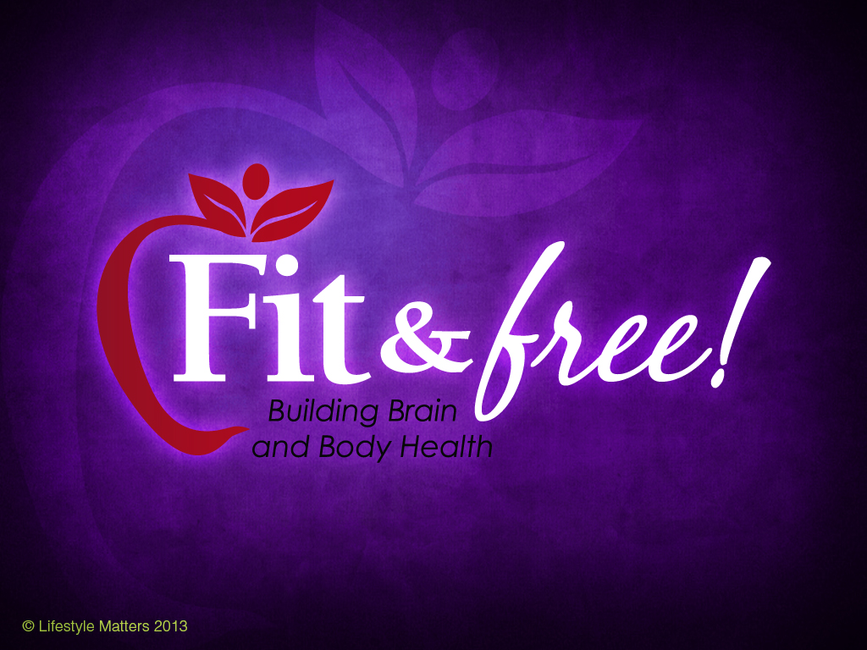

Slide 2
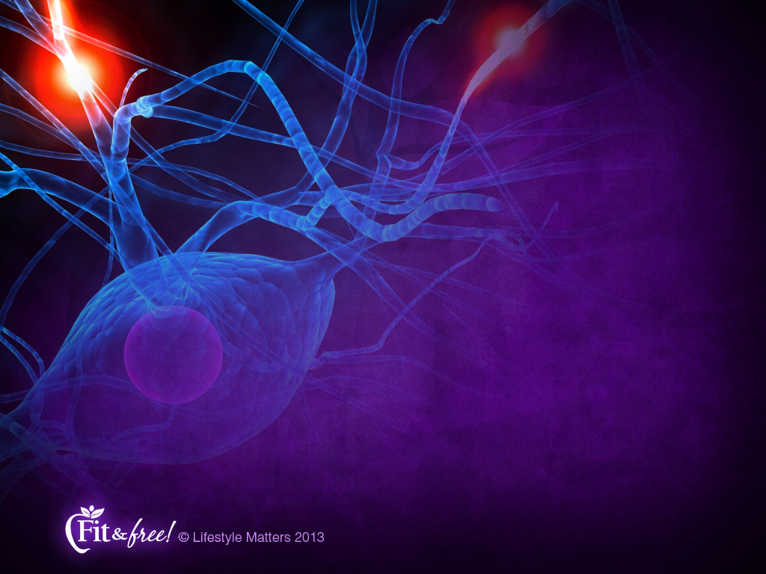
Connection 1:
Engineered
for Success
Notes:
These brains of ours…can they change, adapt, and improve all through life?
In this session we are going to see how your brain is designed for renewal, restoration, and repair.

Slide 3
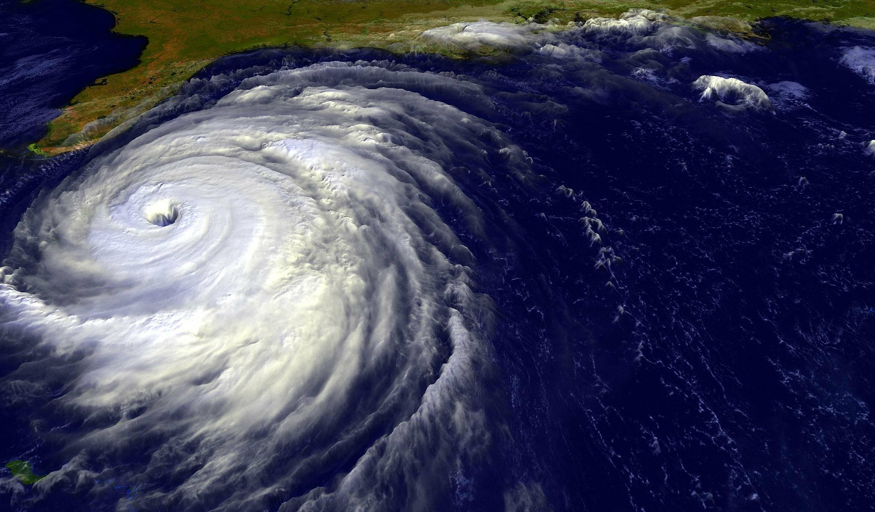
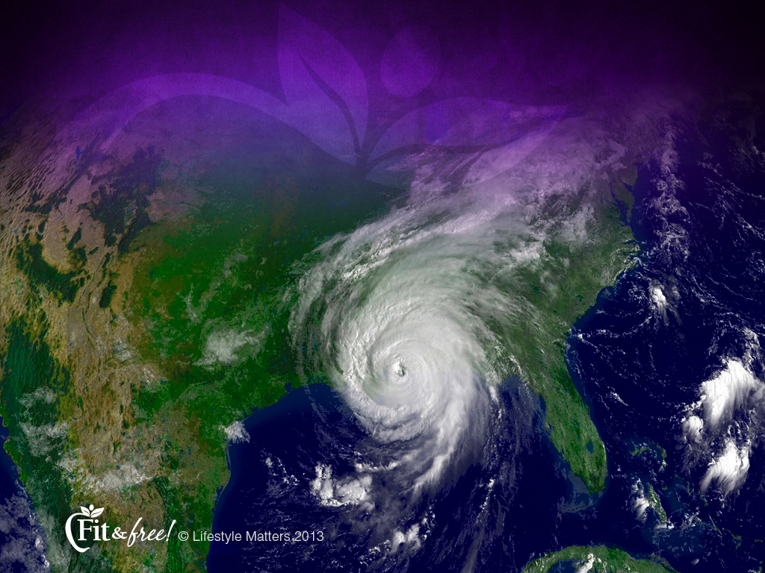
Katrina
Notes:
Let’s begin by taking a look at a Super Storm we all vividly remember. Katrina. Can we ever forget that name?
Katrina was the name of the second strongest hurricane in U.S. history.
On August 23, 2005, it slammed into New Orleans, Louisiana, and several other states with winds up to 174 mph.

Slide 4
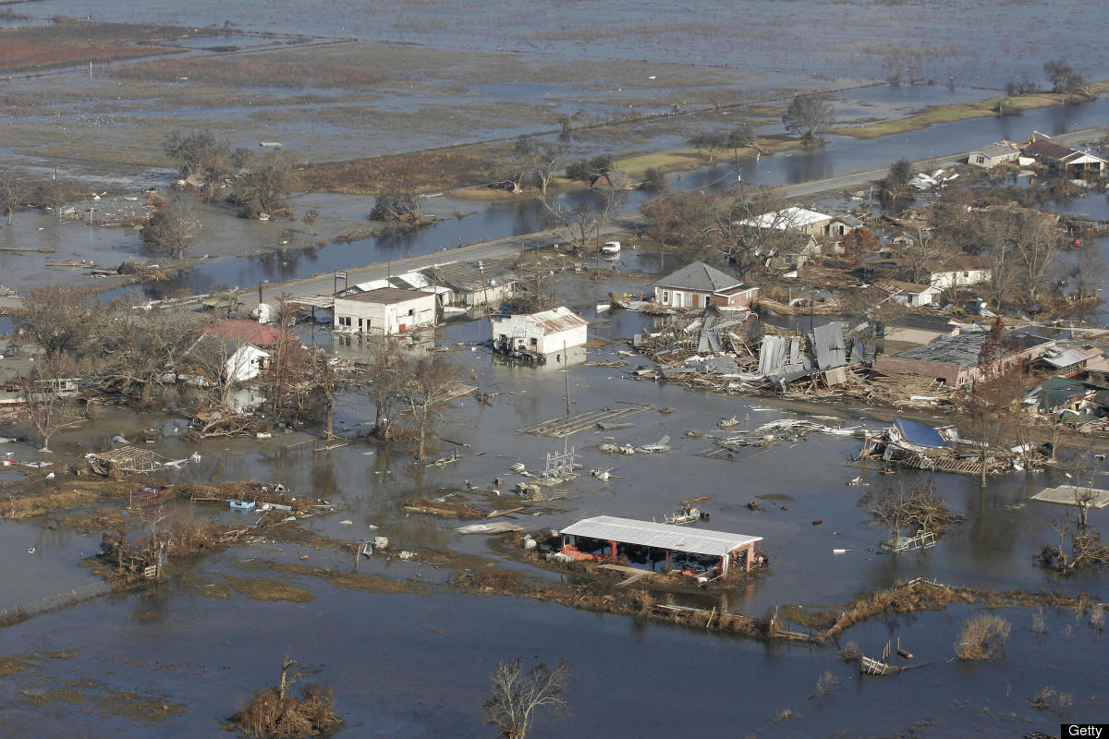
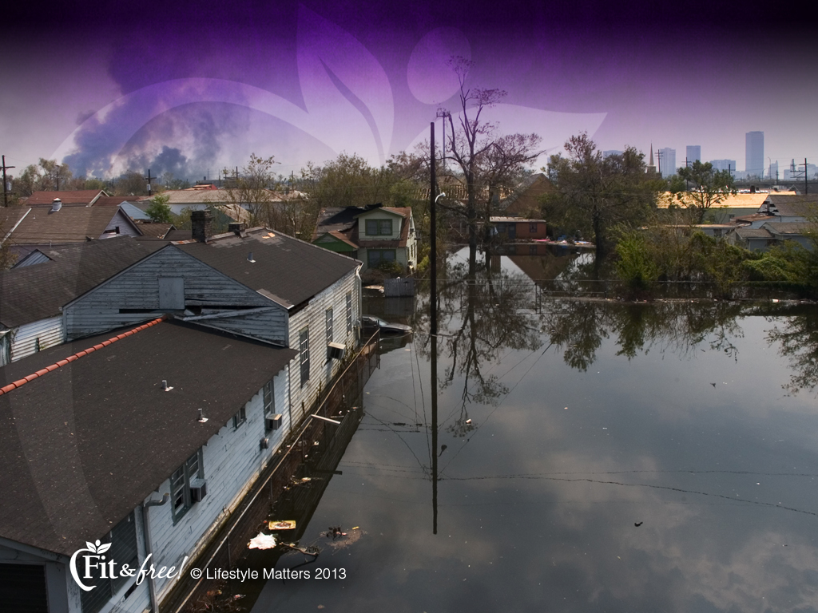
Notes:
The storm surge was 20 feet high; 80% of New Orleans was under water.
It affected nearly 15 million people and nearly 2,000 were killed.
The damage to the infrastructure was estimated at $75 billion, earning Katrina the title of the costliest hurricane in U.S. history.

Slide 5
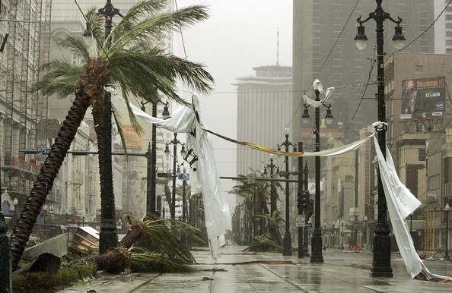
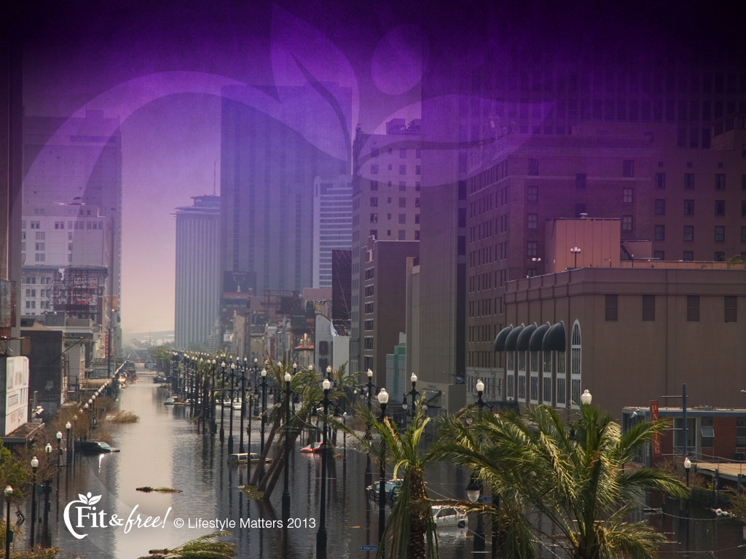
Notes:
A storm-ravaged city like Katrina has at least two major challenges:
Damaged infrastructure such as communication and transportation systems.
Weakened defense systems to protect against danger.

Slide 6
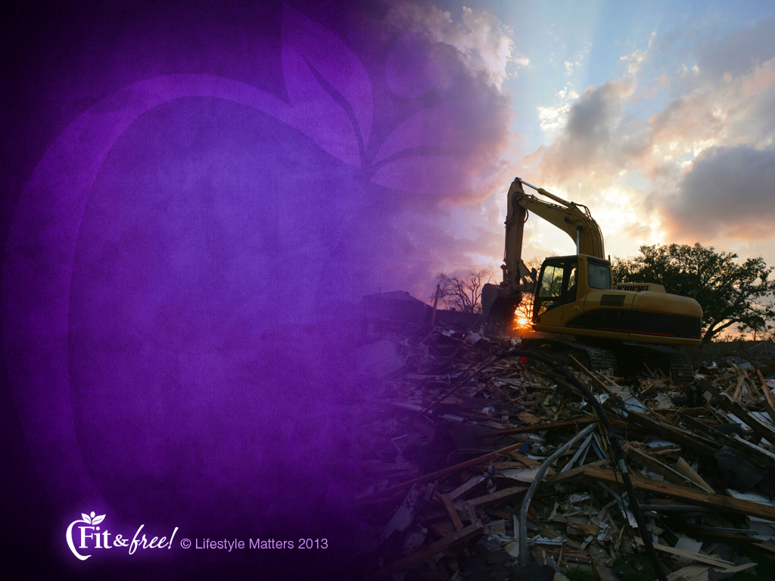
A Broken City Has:
Damaged infrastructure
Weakened defenses
Notes:
Summarizing its condition (this and the next slide):
Read slide
Such a city has lost its synchrony and vitality.
Its broken communication and transportation systems shut down the city’s normal operations .
With weakened defenses, the city is especially vulnerable to vandalism and violence.

Slide 7

A Broken City Has:
Ceased normal function and is now switched to survival mode
Notes:
Read slide
Plans for development and growth are shelved as the city switches into survival mode.
Have you ever had times when you’ve been in “survival mode?” I think we all have!

Slide 8
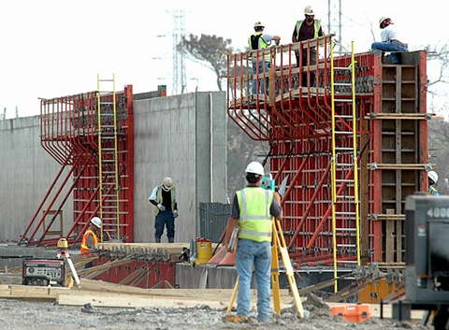
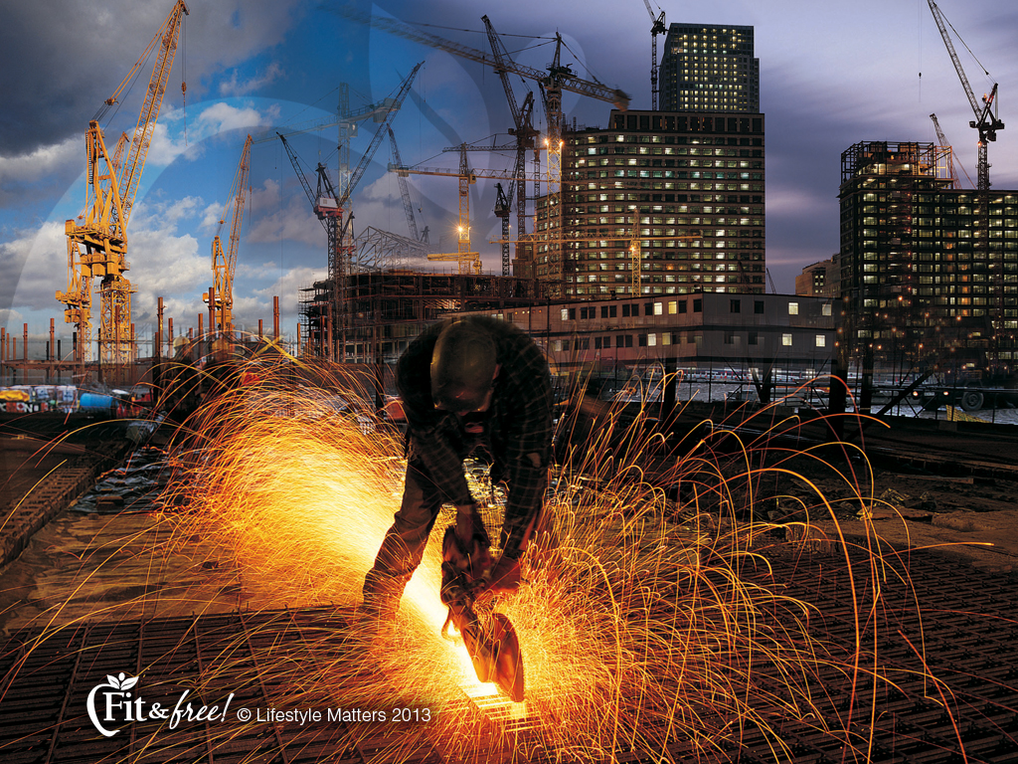
Notes:
When a storm hits, every sector of the city is affected.
It is in need of comprehensive renewal, restoration, and repair.

Slide 9
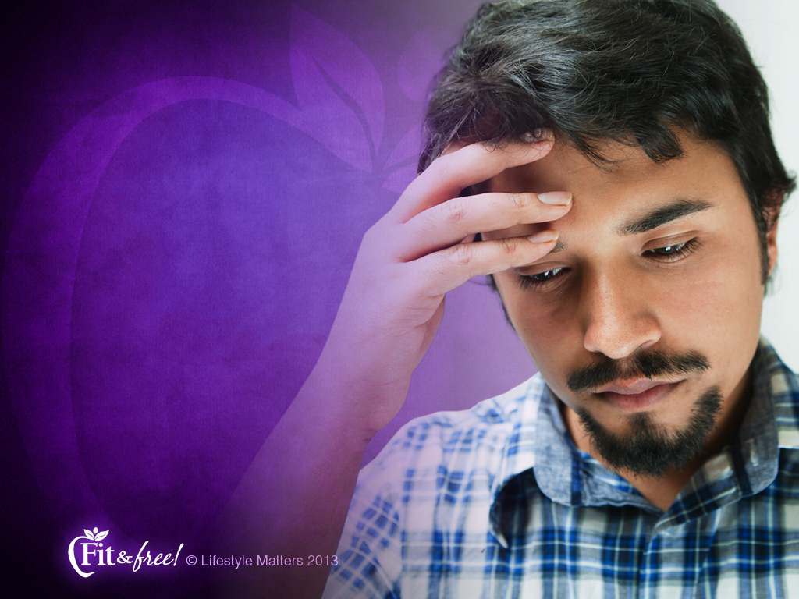
“A person without self control is like a city that is
broken down, and without walls.”
Proverbs 25:28
Notes:
God often uses the things we can see to help us understand the things we cannot see.
Notice this vivid comparison of just such a city with mankind in his broken condition:
Read slide

Slide 10
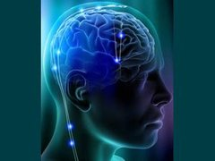
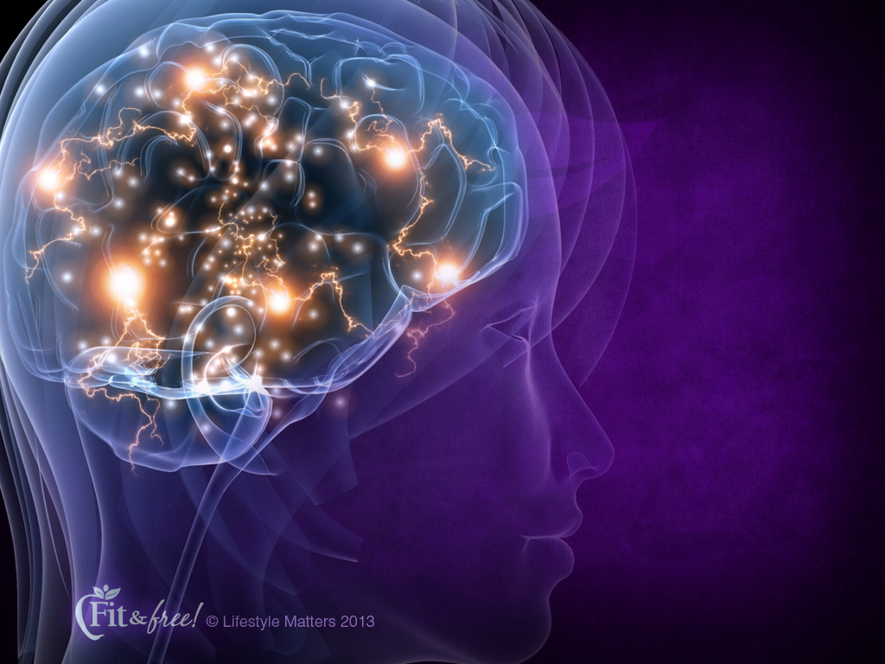
Brain Influences
Stress
Depression
Bad habits
Addictions
Notes:
What kind of challenges can hinder healthy brain function?
Read slide
Yes, that broken city powerfully illustrates the broken brain—a brain that may have been broken down over time by:

Slide 11
Brain Influences
Genes
Environment
Choices
Notes:
There are three major areas that influence your brain:
Read slide
Genes: You cannot change your gene structure: but their function and activity is dramatically influenced by your diet, lifestyle, exercise, and even the way you think.
Environment: Your internal environment is how you think. Your external environment is what surrounds you. You can build an internal and external environment that create a powerful brain advantage.
Choice: Every choice you make, and even how you think, affects your brain.
Every day presents you with opportunities to make choices that will influence the health of your brain, and even how your genes function.
Every choice that improves the health of your brain improves the health of your body.

Slide 12


Rebuilding a broken city requires a plan; so does rebuilding a broken brain.
Notes:
Read slide
Your brain is capable of physical, mental, and emotional improvement and spiritual renewal.
The great news is that you can move forward and continue forward—whether your brain has been hit by a storm of stress, depression, negativity or bad habits.
Even if you haven’t faced a disabling storm in life but simply want to improve your brain and body health, you have come to the right place!

Slide 13
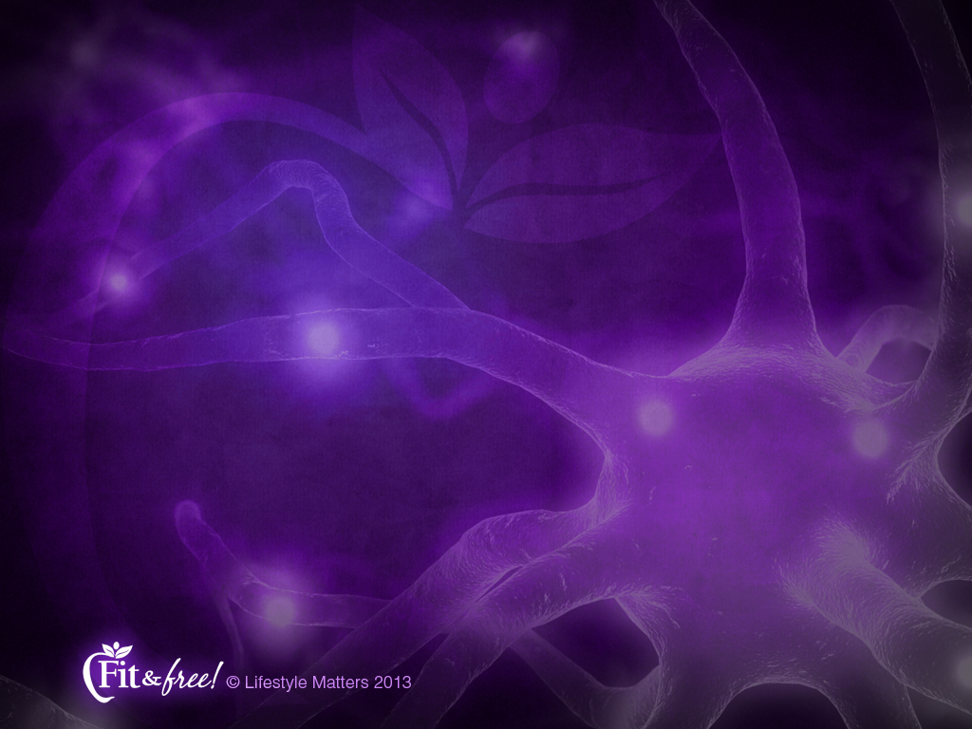
“The brain is a far more open system than we ever imagined, and nature…has given us a brain that survives in a changing world by changing itself.”
Doidge N. The Brain That Changes Itself, p. 26.
Notes:
Dr. Norman Doidge, a psychiatrist and author of the book The Brain that Changes Itself has this to say about the changing nature of our brains:
Read slide
The brain is constantly reshaping itself according to what it learns. This is called “plasticity.”
Plasticity is the term neuroscientists use to describe the remarkable ability of the brain to adapt and change.

Slide 14
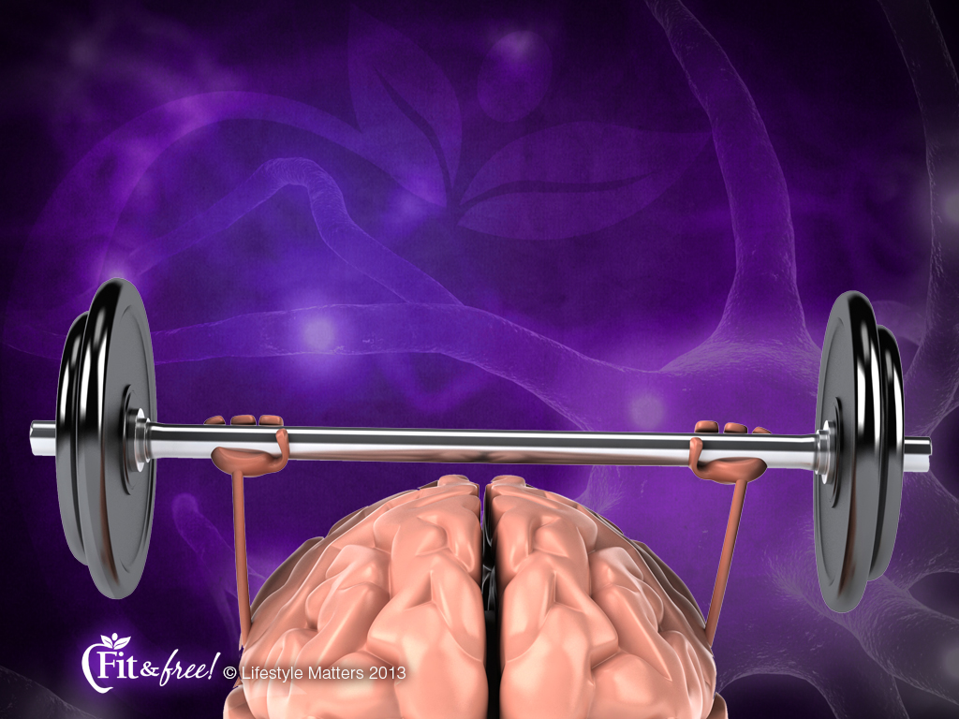
“By viewing the brain as a muscle that can be weakened or strengthened, we can exercise our ability to determine who we become.”
Ratey J. User’s Guide to the Brain, p. 17.
Notes:
Notice this statement by Dr. John Ratey, a neuropsychiatrist and author from Harvard University in his book, “User’s Guide to the Brain”:
Read slide

Slide 15

Healing the Broken Brain
Environment
Assessment
Lifestyle
Connections
Managing Stress
Notes:
How do you heal a broken brain?
There are at least five key areas to consider:
Read slide (Each is briefly summarized on the next 5 slides)

Slide 16

Assessment
Notes:
Assessment:
It is always important to work closely with your physician or healthcare provider.
2. Lifestyle changes may reduce or eliminate the need for certain medications over time.
Use medicine or medical procedures when needed.

Slide 17

Environment
Notes:
Environment: The internal environment of how you think and the external environment you surround yourself with are critical for achieving and maintaining positive change.

Slide 18

Lifestyle
Notes:
Lifestyle: Lifestyle choices are the foundation of mental, physical, and spiritual strength.

Slide 19

Manage
Stress
Notes:
Managing Stress: We all need practical strategies to tap into when confronting challenges and stress.

Slide 20

Connections
Notes:
Connections: Your associations and interests have a profound shaping effect on your values and goals.
Knowing that God’s power and guidance are available gives courage and power for the journey.

Slide 21
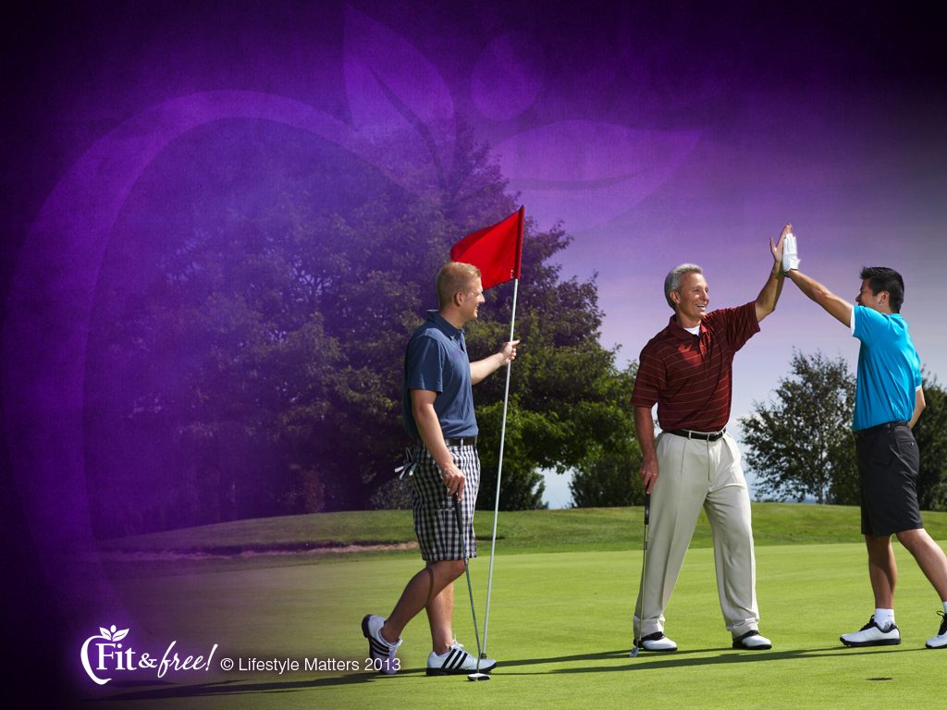
Social Ties Matter
A review of 148
studies on social ties found that people
with strong social
relationships were
50 percent less
likely to die early
than people without
such support.
Notes:
How important are positive social ties?
How important are such activities as family gatherings, getting together with friends, participating in special religious, community, and workplace activities?
Read slide
Social connections provide an opportunity to check in with each other, exchange ideas, and perhaps lend a supportive ear or shoulder.

Slide 22

Social Ties Matter
"A lack of social relationships was equivalent to smoking up to 15 cigarettes a day…
Notes:
Read slide
Quiet time is great; but a relative lack of social ties is associated with depression and later-life cognitive decline, as well as with increased mortality.
One study, which examined data from more than 309,000 people, found that lack of strong relationships increased the risk of premature death from all causes by 50%.
This meant an effect on mortality risk roughly comparable to smoking up to 15 cigarettes a day, and greater than obesity and physical inactivity.
Social relationships and mortality risk: a meta-analytic review.
Holt-Lunstad J, Smith TB, Layton JB.
PLoS Med. 2010 Jul 27;7(7):Review.

Slide 23

Social Ties Matter
“I certainly don't want
to downplay these
other risk factors
because of course
they are very important.
But we need to start taking social relationships just as seriously."
Julianne Holt-Lunstad, PhD; Brigham Young University
Notes:
Read slide
Social connections like these not only give us pleasure, they also influence our long-term health in ways every bit as powerful as adequate sleep, a good diet, and not smoking.
Dozens of studies have shown that people who have satisfying relationships with family, friends, and their community are happier, have fewer health problems, and live longer.

Slide 24

Spiritual Well-being
“Growing research has demonstrated
a link between spiritual well-being and better health.”
J Behav Med 2011;34(6):477-88
Notes:
Read slide
Spiritual well-being is at the center of a healthy lifestyle.

Slide 25

Spiritual Well-being
Lower:
Blood pressure
Inflammation
Cholesterol
Fasting blood sugar
Notes:
A close relationship with God is not only linked to a healthier immune system and reduced risk for depression and addictions, it also has remarkable heart-health benefits:
Read slide:

Slide 26

Designed for a Relationship
“I am fearfully and wonderfully made!”
Psalm 139:14
Notes:
Read slide
The “God created man in His own image.” Genesis 1:27
How? He gave you the intellect to reason about your existence; the capacity to know him; the ability to experience His love and share it with others.

Slide 27

Designed for a Relationship
“O Lord, You have searched me and known me. You know when I sit down and when
I rise up…
Notes:
Read slide
God knows all about you.
He knows where you are and what you need.

Slide 28
Designed for a Relationship
…You understand my thoughts from afar. You keep watch over my steps and my sleep, and have knowledge of all
my ways.”
Psalm 139:1-3
Notes:
Read slide
God keeps watch over you in every condition and situation of your life.

Slide 29

Designed for a Relationship
“How precious are Your thoughts to me, O God! How vast is the sum of them! If I would count them, they are more in number than the grains
of sand.”
Psalm 139:17-18
Notes:
Read slide
You are in the heart of God continually.

Slide 30
God’s Power is for You
“That you may be strengthened in every kind of strength by the might of his glory for every kind of patience and fortitude with good cheer.”
Colossians 1:11
Notes:
Read slide
He invites you to come to Him for patience, perseverance and power for your journey.

Slide 31

God’s Promises are for You
“Those who wait
for the Lord will have
new strength; they will mount up with wings like eagles: they will run and
not be weary; they will walk and not faint.”
Isaiah 40:31
Notes:
Read slide
God promises to personally guide, strengthen, and sustain you.

Slide 32

God’s Plan is for You
“For I know the plans I have for you, says the LORD, plans for your welfare and not for evil, to give you a future and a hope.”
Jeremiah 29:11
Notes:
Read slide
God cares about your welfare; He has a plan, and He wants you to walk in hope.

Slide 33

“The idea that the brain is like
a muscle that grows with exercise is not just a metaphor.”
Doidge M. The Brain That Changes Itself, p. 43.
Notes:
Dr. Doidge, in The Brain That Changes Itself states:
Read slide

Slide 34
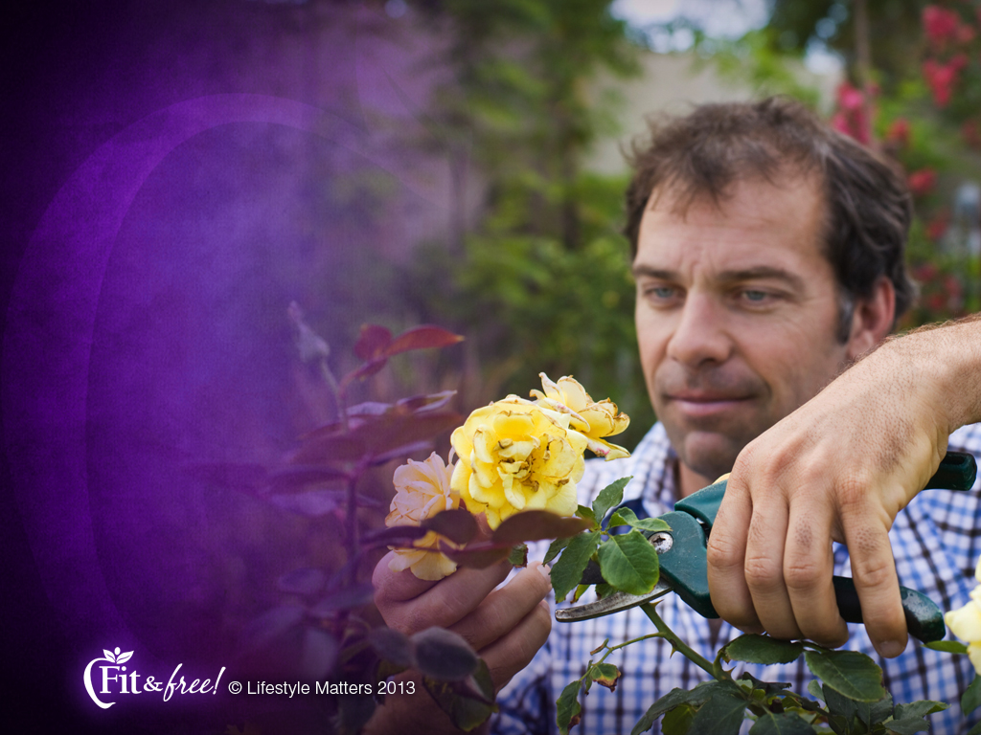
“Experiences, thoughts, actions, and emotions actually change the structure of our brains.”
Ratey J. User’s Guide to the Brain, p. 17.
Notes:
Read slide
Your brain changes with your thoughts and emotions.
Knowing that you are created by God and the God is personally watching over you, helps heal a broken brain.

Slide 35
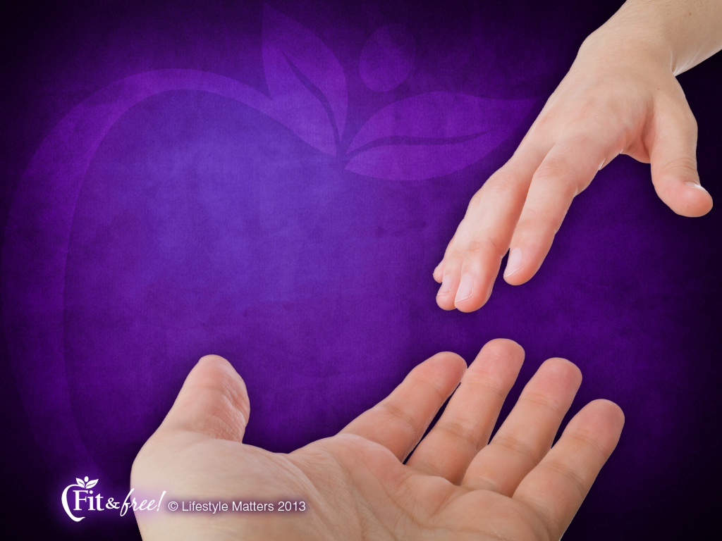
You Can Trust God
“You hold me by my right hand. You will guide me with Your counsel.”
Psalm 73:24, 28
Notes:
Read slide
Isn’t it great that our brains respond to a healthy diet; exercise; social connections; and a relationship with God through His Word?
Would you like to experience these wonderful changes in your life? If so, raise your hand with me.

