Slide 1
NADhealth.org/healthyYOU
Movement. We Were Made for This.

Slide 2
Notes:
Use these first few slides for marketing or announcements. Choose the best option for your church.

Slide 3
Notes:
Use these first few slides for marketing or announcements. Choose the best option for your church.

Slide 4
Notes:
Use these first few slides for marketing or announcements. Choose the best option for your church.

Slide 5
Notes:
Use these first few slides for marketing or announcements. Choose the best option for your church.

Slide 6
Notes:
Use these first few slides for marketing or announcements. Choose the best option for your church.

Slide 7
Notes:
Happy Sabbath to everyone! I am so delighted to be with you all today on this very special sabbath as we launch out into the unknown frontier of pursuing our health goals. The Made to Move Challenge is a program birthed from our Division Health Department leader, Dr. Angeline Brauer and her team. It possesses a message in its very name. It asserts a profound and simple theological truth that we are made to move. As Psalm 100 reminds us, "It is the Lord who has made us and not we ourselves..." And the Lordby His very own design, made us to move. It is my prayer that at the end of this message, you will accept the Spirit's call to do what you were made to do...that is to move. [Let us pray...]

Slide 8
Notes:
I want to start by asking you a question: Are you are an 8 percent?.According Michael Gregor, famed plant-based advocate and fellow of the American College of Lifestyle Medicine, only 8% of Americans can say yes to these 5 statements. [Read statements] If you can say yes to these 5 statements, then you are an 8%'er! Congratulations! You should now go and request to be the Health Ministries leader in your church! (Smile)Notice the second statement...I exercise 30 min or more most days of the week. That means at least 4x or more each week.One could argue that even though our church advocates a vegetarian-plant-based diet, most of us cannot affirm the 3 statement, but that's a sermon for another Sabbath.Nevertheless, it seems that among our Adventist Church communities, we have emphasized what we eat so much that we have neglected another critical law of health and our being, namely: exercise and movement.In fact, this has been a problem in America for quite a while...(next slide)

Slide 9
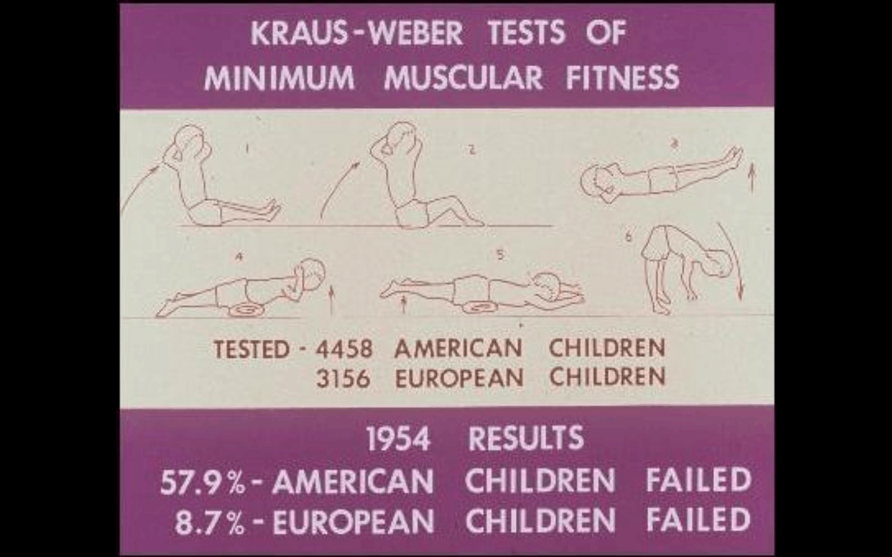
Notes:
In 1954, there was a study done on American and European children, called the Kraus-Weber. This test put the children through a litany of physical tests. The assessment essentially stated that starting from early adolescence, we in America do not appear as fit as those in Europe.

Slide 10
Notes:
Right around this same time, researchers in American fitness discovered a principle called the SAID principle, which stands for Specific Adaptation to Imposed Demands. In other words, our bodies will naturally adapt to our environmental demands. This inspired ideas around the health world to grapple with ways to increased the imposed demands upon the body. Then came the idea that: if we find ourselves in a physical decline, then we just need to impose greater demands upon ourselves and our bodies will adapt. This led to the eventual birth of the first gym: Gold's Gym and all the subsequent fitness centers we find today. And despite all the available fitness centers... (next slide)

Slide 11
Notes:
60% of Adults do not get enough exercise! And 25% of Adults do not exercise at all! Now, you may be thinking, "But some gyms are really expensive." But when you have gyms such as Planet Fitness with prices as low as 10$ per month, the monetary excuse doesn't go very far. In fact, there's a fitness center in Topeka, Kansas that offers its members a free membership if they visit the gym at least 5 days per week for an entire month. They are still in business and quite profitable.

Slide 12
Notes:
Social media has us enthralled with supposed results of others through some questionable fitness practices and workouts. Where we believe that exercise is similar to godliness in that we have to die to live. So we find the most intense fitness programs, such as CrossFit, and throw ourselves into them to show we're serious about our fitness goals. The result, more often than not, is that we end up injured at worst or feeling defeated at best, thinking that fitness is just too hard. That we were not made to move like that. Our health fate is sealed.

Slide 13
Notes:
And now that we have given up on our fitness goals as unrealistic and unattainable, we sentence ourselves to life in unfitness, without possibility of parole.
So what happens if we don't do what we were made to do? We begin to suffer the affects of not doing what we were made to do.
This lack of exercise causes our stress levels to increase, reduces our mental clarity, and directly affects our blood circulation quality.

Slide 14
Notes:
In fact, not doing what we were made to do leads to a host of painful but preventable diseases such as Type 2 Diabetes, High blood Pressure, and the number 1 preventable cause of death: Heart Disease.

Slide 15
Notes:
So why do I say that we were made to move? Let’s start by recognizing that our bodies are shaped by 2 fundamental factors. First, our DNA. This informs several aspects of our physical makeup and sets the baseline. The second is our environment. Our bodies adapt to our environment. Thus, someone born on a farm will have a different physique than someone born into a family of business and minimal activity, despite their DNA makeup. This can be seen in the progressive development of a child…(next slide)

Slide 16
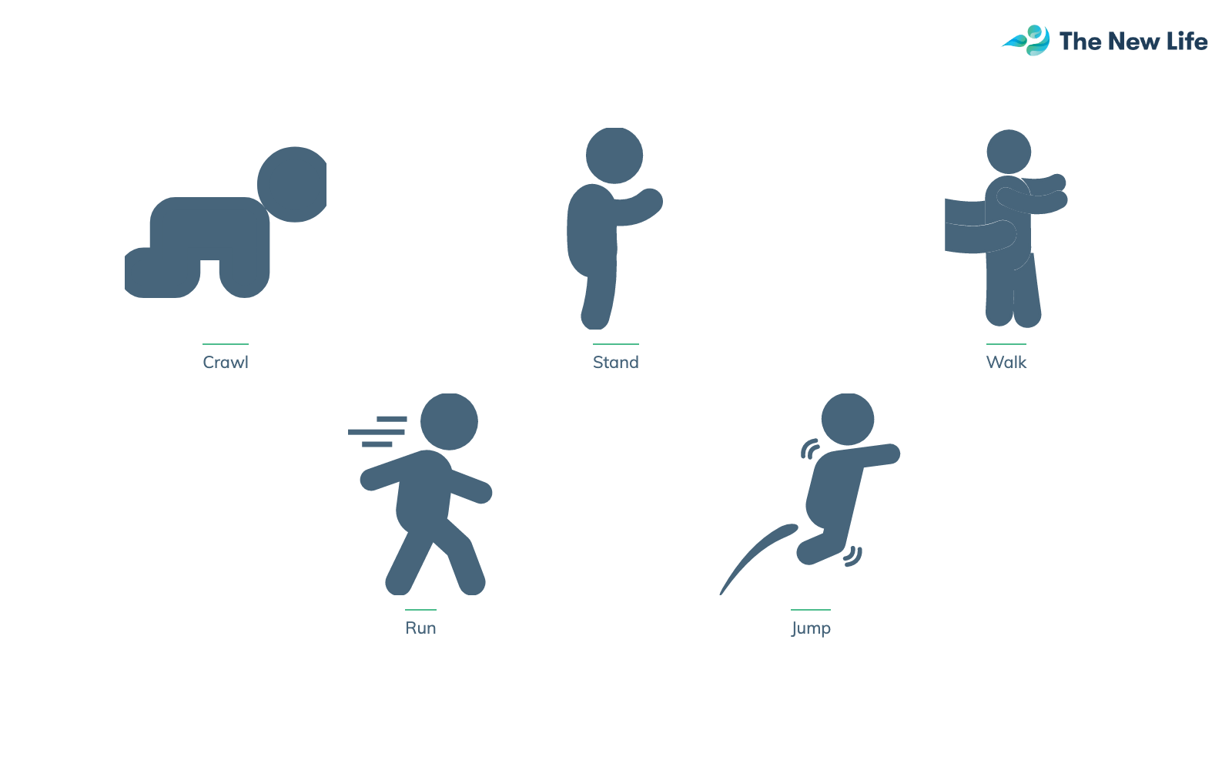
Notes:
Think about this…A new born baby learns to lift its head, sit up, hold itself up on its hands and knees, stand, walk, run, and jump and so on without a gym or a personal trainer! How is this possible?
There are several elements involved in this process. The first is that our brains love movement data. Our brain is constantly taking in the environment and adapting the patterns of movement to adapt to that environment and thrive.
Secondly, movement and specific movement patterns seem to programmed into our DNA by God. A child didn’t need a tutorial, youtube video, or a trainer to learn to stand. The components, muscles, and capacity to achieve that movement were all designed by God inside their genetic code. Last but not least is the environment. Things like gravity, the ground, furniture and so on all inform the child’s body and helps it adapt to survive in its environment. (next slide)

Slide 17
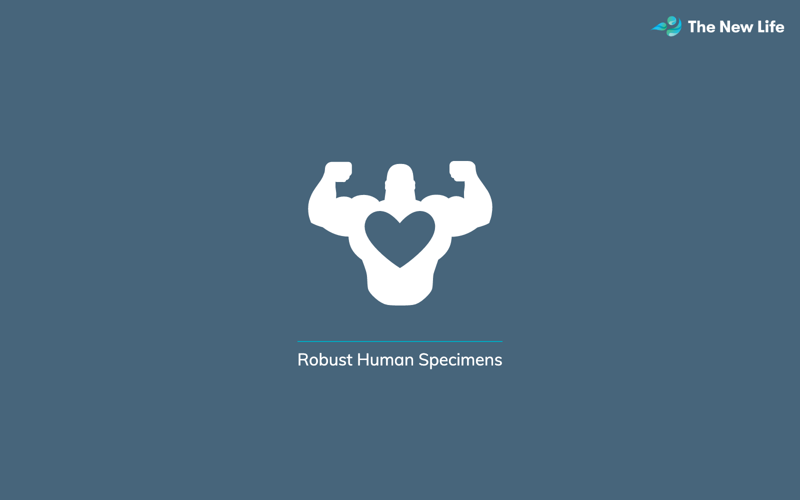
Notes:
You can ask any renowned fitness trainer, and they will tell you that the strongest animals and most robust human specimens we have ever seen were not created in a gym or by a trainer.

Slide 18
Notes:
The transformation of an infant to a child who can run, jump and climb could be encapsulated into one core principle: we must 1st Move Well, then Move Often.. Rather than the faulty assumption that if we move often, we will eventually move well, we must first seek quality of movement and then quantity of movement. This ensures our safety in our workouts and the longevity of our exercise habits. We can be consistent without worry of injury!
But what exactly do we mean by moving well? (next slide)

Slide 19
Notes:
Let’s start with an illustration. Let’s imagine that I left you in the library of congress for one whole year with complete and unlimited access to all the books there but you couldn’t read. When I returned after a year, would you be any better or smarter? Of course not! You would have been surrounded by immense knowledge that was inaccessible to you. If anything, you’d be frustrated. (next slide)

Slide 20
Notes:
This brief analogy is the equivalent of dropping a person off in a gym or fitness center but they cannot read or write movement. We’re surrounded by tools and resources that, if rightly understood, could radically improve our fitness and performance. However, our movement illiteracy prevents us from benefiting from this “library of movement.” This can ultimately lead to harm and a terrible end to our fitness journey. (next slide)

Slide 21
Notes:
This concept was illustrated in 1999, when Gray Cook, a physical therapist for major university sports programs around the country, was called to assess a collegiate athlete. According Gray, “This student’s body was wrecked. But the shocking element was that it wasn’t his sport or competition that did this to him but his workout. It was his workout that had taken him into dysfunctional movement.”
In other words, his illiteracy regarding movement led him down a path of severe injury that would take years to recover from. Gray wondered if there was, anyway, he could have prevented this?
This led him to create… (next slide)

Slide 22
Notes:
The Functional Movement Screen. A series of 7 patterns of movement, that Gray felt that if he could see someone move in these patterns, he could spot the dysfunction before it lead to life altering injury. These patterns stem from God’s programmed pattern of development that we all have experienced before we could even remember. This screen provides a baseline for movement quality and alerts a person to areas of greater movement literacy while allowing them to pursue their health goals injury free!
While it is helpful for us to explore an increase in our movement literacy of our bodies, it is equally important, according to the apostle Paul that we apply this same energy to our spiritual lives. (next slide)

Slide 23
Notes:
Our first text of mediation is 1 Timothy 4:6-8.

Slide 24
Notes:
(Read the text). Notice here that the apostle states that by instructing others in the quality bible teachings, we nourish ourselves in the words of faith and good teaching. If we were to have a nutritionally focused sabbath, then here would be the spiritual reality behind it. As good food is to the body, so are words of faith and good doctrine! But Paul goes on… (next slide)

Slide 25
Notes:
(Read the text). In opposition to good doctrine, there are profane (or offensive to God) and old wive’s fables that Paul says we should reject. They are the type of food that is not good for our souls.
Instead, the Apostle encourages us to exercise ourselves toward godliness. In other words we need to train ourselves with our full effort towards living like God. We need to train ourselves with complete physical and emotional force, like when exercising in a gym. We must ask ourselves, have we been exercising our souls? Have we trained our minds to rightly divide the word of truth (2 Timothy 2:20)? Have we trained our hearts to pray without ceasing? Have we trained our lips to speak words of life? Have we exercised ourselves toward godliness? (next slide)

Slide 26
Notes:
(Read the text). But now the apostle gives explanation for this recommendation. He first admits that bodily exercise does have benefits. Paul says it benefits a little. The original word here suggests something puny or an effect that is short lived. But godliness is huge in its benefits, improving every area of life and has benefits that last beyond this life. Thus, Paul connects bodily exercise to soul exercise. One is an example, a type, a model of the other. Exercise is beneficial if it is consistent, so it is for the soul. Exercise can be one of intensity, duration, or frequency…so it is for the soul. We must think of the intensity of our prayers, studies, and evangelism. We must think of the duration of our prayers, fastings, and bible readings. It was E.M. Bounds who said, “It is as difficult to pray, as it is to live a holy life.” But let’s look at the benefits of bodily exercise that Paul calls puny…(next slide).

Slide 27
Notes:
Bodily exercise lowers blood pressure. A condition suffered by over a billion people in the world. But Paul says that’s just puny compared to godliness.
Bodily exercise increases insulin sensitivity. Aiding in the prevention and reversal of Type 2 Diabetes, one of the fastest growing conditions in the world and directly linked to heart disease. But Paul says that’s just puny compared to godliness.
Exercise can lower bad cholesterol. And walking is linked to less obesity. All puny compared to godliness. (next slide).

Slide 28
Notes:
Regular exercise leads to a strong heart, and even helps prevent and fight cancer. The disease that feels like a death sentence when we hear we have it. Exercise helps to prevent and fight it! But to the apostle, that is puny compared to godliness! (next slide).

Slide 29
Notes:
Research has shown that walking calls more muscles into action than any other exercise! Increased breathing during a workout, leads to increased oxygen which plays a key role in burning calories and fat.
Anybody need to burn some calories? Any body need to burn some fat? Here is a benefit of exercise. But that is puny compared to Godliness according to the apostle Paul.
(Next slide).

Slide 30
Notes:
According to the American College of Sports sciences, bodily exercise can help fight allergies! But that is puny according to the Apostle Paul, when compared to the benefits of godliness.

Slide 31
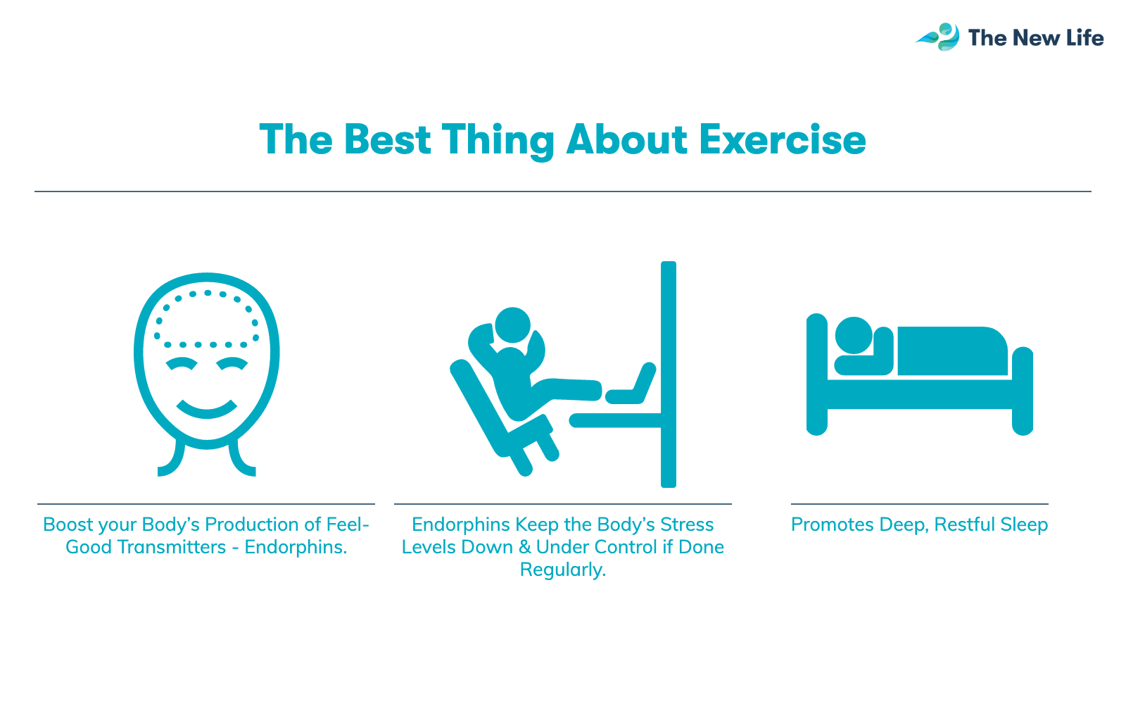
Notes:
Research has shown that exercise boosts our feel-good hormones such as endorphins. These endorphins, when released regularly, keep our body’s stress levels down and under control. This also promoted deep and restful sleep.
Who doesn’t need some happy hormones flowing through their body?! Who couldn’t benefit from a stress level reduction?! Who couldn’t use some deep, restful sleep?! These are the puny benefits, according to Paul of bodily exercise.
When compared to the benefits of godliness.

Slide 32
Notes:
David C. Neiman has research showing that bodily exercise helps our immune system and cleans up our bodies! All puny benefits compared to Godliness!

Slide 33
Notes:
Just like physical exercise, spiritually, the best practices are those that we can stick with and do regularly. There are less benefits of physical or spiritual exercise when it is done intensely only here and there rather than when it is consistent.
The key element here is to realize that physical exercise helps us build the discipline required for spiritual exercise. Godliness calls more “muscles into action” than any other exercise, because it calls our bodies, minds, and spirits into rigorous activity!

Slide 34
Notes:
In Ministry of Healing, on page. 237, this statement is made: (Read quote on screen). Who made us this way? In whom do we have our being?
None other than Jesus our maker. Notice these words of Holy Scripture… (next slide)

Slide 35
Notes:
The bible tells us in Psalm 139:14..(read the slide). We were not evolved or experimented into existence but made. Fearfully and wonderfully. Built. Formed. Assembled. Designed. Hand-crafted. By Jesus to move…And Isaiah reminds us that Jesus made us for His glory. (Isaiah 43:7)
In the 1920’s there was a British runner, Eric Liddel, born to Scottish missionary parents in China. However, he was spotted by an Olympic scout and committed to the 1924 Paris Olympics. While training, his missionary partner, Mary, felt that Eric was more committed to running in the Olympics than his calling to be a missionary to China. Eric is noted as responding, “ Mary, God called me to be a missionary, but God also made me fast and when I run, I feel His pleasure...” He went on to make it to the gold medal race only to refuse to run due to his convictions about the sabbath (Sunday as he believed). His refusal, however, placed his decision on the cover of every newspaper of almost every country in the world. Because godliness accomplished more than his running could have ever accomplished in his witness for the glory of God.
We too can feel God’s pleasure of doing what we were made to do… and that is that we were…(next slide)

Slide 36
Notes:
Made to move. I want to personally invite you to accept this challenge. To allow this health focus to be a reset for you. To move and in every cool breeze during a run, every good feeling you have after that walk or workout, feel God’s pleasure. For you are doing what you were made to do…(pray).
Then offer the website information of how to signup for the program and website or next steps to get involved.

