Slide 2
God’s Plans for Your Life
David R. Williams, PhD, MPH, MDiv Professor, Harvard University

Slide 3
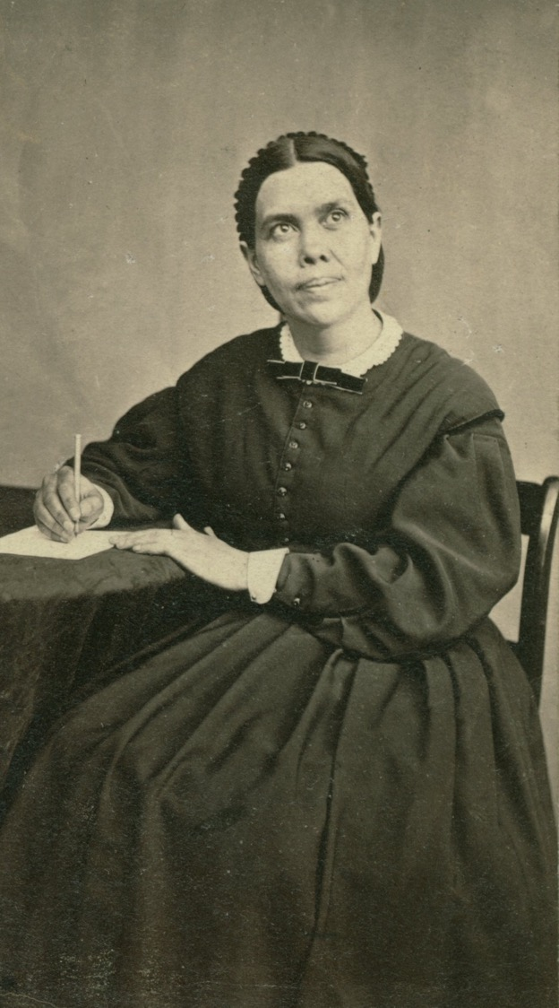
MAKING LOVE REAL
“Words of kindness, looks of sympathy, expressions of appreciation, would to many a struggling, lonely one be as a cup of cold water to a thirsty soul.”
Testimonies to the Church, vol 7, 50
Courtesy of the Ellen G. White Estate, Inc.

Slide 4
THE ONLY KEY TO SUCCESS
“Christ’s methods will give true success in reaching the people.”
The Savior mingled with others
As one who desired their good
He showed His sympathy
Ministered to their needs
Won their confidence.
Then He bade them, ‘Follow Me.’
Ministry of Healing, 143
Courtesy of the Ellen G. White Estate, Inc.

Slide 5
THE TEST OF TRUE CHRISTIANITY
“By this shall all men know that ye are my disciples, if ye have love one to another.”
John 13:35

Slide 6
THE TEST OF TRUE CHRISTIANITY
Living: “Your love for one another will prove to the world that you are my disciples.”
Message: “This is how everyone will recognize that you are my disciples -- when they see the love you have for each other."

Slide 7
DEATHS OF COVID-19, THROUGH JUNE 24, 2020
28.5 - White
65.8 - Black
31.1% - Hispanic
27.7% - Asian
DEATHS PER 100,000
APM Research Lab, http://www.apmresearchlab.org/covid/deaths-by-race

Slide 8
COVID-19 DEATHS BY RACE
If all racial/ethnic groups had died at the same rate as white Americans, at least:
15,000 Black Americans
1,500 Latinos Americans, and
250 Indigenous Americans
would still be alive

Slide 9
WHY RACE MATTERS?
There are Large Racial/Ethnic Differences in Economic Status

Slide 10
MEDIAN HOUSEHOLD INCOME AND RACE, 2018
$70,642 - Whites
$87,194 - Asians
$51,450 - Hispanics
$41,882- American Indians*
$41,361- Blacks
U.S. Census Bureau, Semega et al., 2019; *for 2017; US Census Bureau, ACS, 2017

Slide 11
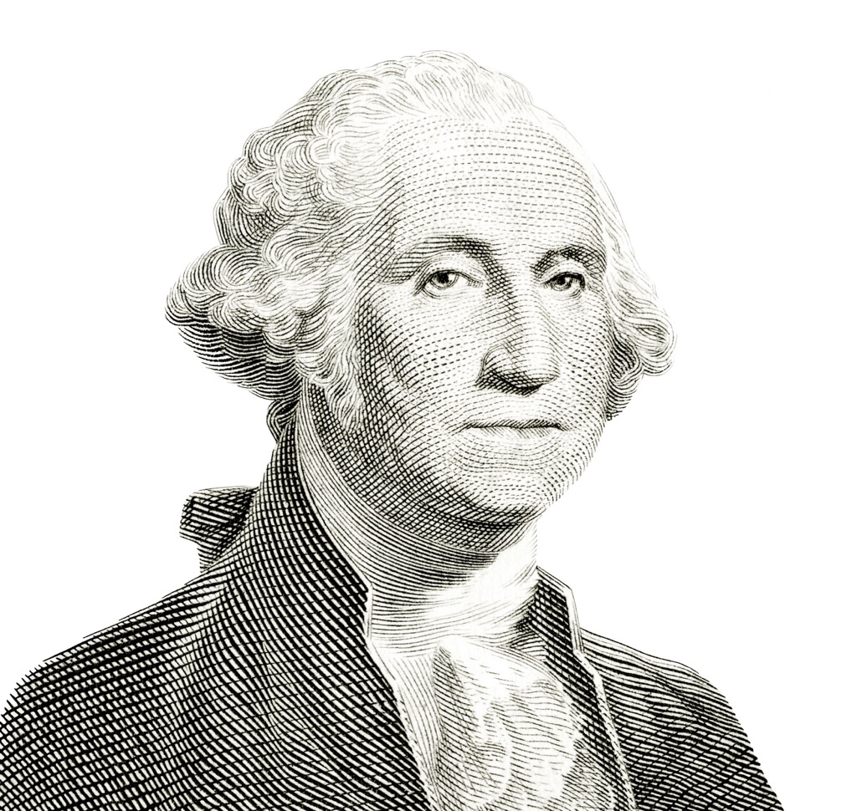
MEDIAN HOUSEHOLD INCOME AND RACE, 2018
$1.00 - Whites
$1.23 - Asians
$0.73 - Hispanics
$0.59 – Am. Indians
$0.59 - Blacks

Slide 12
POVERTY AND RACE, 2018 (PERCENTAGE)
20.8% - Black
10.1% - Asian
25.4% - Am. Indian*
17.6% - Hispanic
8.1% - White
U.S. Census Bureau, Semega et al., 2019; *For 2017; US Census Bureau, ACS, 2017

Slide 13
POVERTY AND RACE, 2018 (IN MILLIONS)
8.9 - Black
2.0 - Asian
0.7- Am. Indian*
10.5- Hispanic
15.7- White
U.S. Census Bureau, Semega et al., 2019; *For 2017; US Census Bureau, ACS, 2017

Slide 14
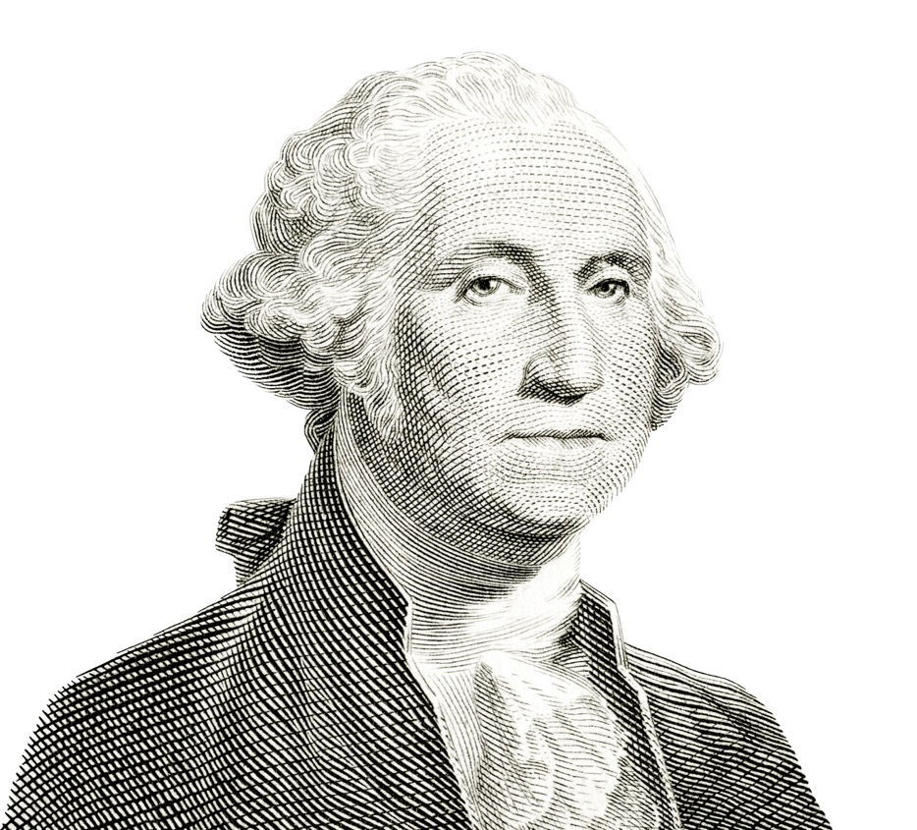
MEDIAN WEALTH AND RACE, 2016
For Every Dollar of Wealth that Whites have…
Blacks have 10 cents
Latinos have 12 cents
Other races have 38 cents
Dettling et al., FEDS Notes, Federal Reserve Board (SCF), 2017

Slide 15
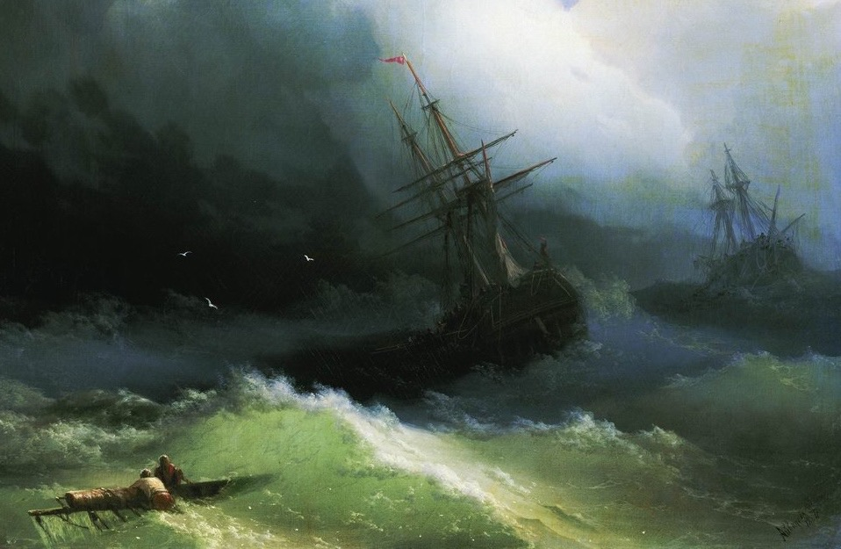
WHAT LOW ECONOMIC STATUS MEANS:
We are in the same storm but in different boats

Slide 16
LOW INCOME & COVID-19
Not everyone can work from home
For low-wage, non salaried workers with unpredictable and unstable hours, working from home is a luxury.
In poor neighborhoods, with overcrowded housing, social distancing is not a viable option.

Slide 17
LOW INCOME & COVID-19
Low income and minority workers overrepresented among essential workers – our drivers, building maintenance staff, and grocery store employees.
People who struggle financially often struggle to live a healthy life.

Slide 18
OUR EXAMPLE
“The Word became flesh and blood, and moved into the neighborhood. We saw the glory with our own eyes, the one-of-a-kind glory, like Father, like Son. Generous inside and out, true from start to finish.”
John 1:14, Message

Slide 19
WALKING IN HIS STEPS
“…in order to walk in the steps of Jesus. We shall find His footprints beside the sickbed, in the hovels of poverty, in the crowded alleys of the great city, and in every place where there are human hearts in need of consolation. In doing as Jesus did when on earth, we shall walk in His steps.”
Desire of Ages, 640
Courtesy of the Ellen G. White Estate, Inc.

Slide 20
OUR MARCHING ORDERS
”Is not this the fast that I have chosen? To loose the bands of wickedness, to undo the heavy burdens, and to let the oppressed go free, and that ye break every yoke?
Is it not to deal they bread to the hungry, and that thou bring the poor that are cast out to thy house? When thou seest the naked, that thou cover him; and that thou hide not thyself from thine own flesh?”
Isaiah 58:6-7,KJV

Slide 21
COMPREHENSIVE HEALTH MINISTRY
Instruction in principles of health
Instruction in nutrition
Cooking schools and demonstrations
Instructions in simple treatments
Childcare (training, homes, adoptions)
Ministering in church health clinics/centers

Slide 22
COMPREHENSIVE HEALTH MINISTRY
Health combined with public evangelism
Health conditioning centers (sanitariums)
Comforting the afflicted
Caring and providing for people and their problems

Slide 23
THE PROMISES
“And if you give yourself to the hungry, and satisfy the desire of the afflicted, then your light will rise in darkness, and your gloom will become like midday. And the LORD will continually guide you, and satisfy your desire in scorched places, and give strength to your bones; and you will be like a watered garden, and like a spring of water whose waters do not fail.”
Isaiah 58:10-11,NASB

Slide 24
GOD’S CALL: THE LEAST OF THESE
“Then the King will say to those on His right, ‘Come, you who are blessed of My Father, inherit the kingdom prepared for you from the foundation of the world. For I was hungry, and you gave Me something to eat; I was thirsty, and you gave Me something to drink; I was a stranger, and you invited Me in; naked, and you clothed Me; I was sick, and you visited Me; I was in prison, and you came to Me.’”
Matthew 25:34-36,NASB

Slide 25
OUR ETERNAL DESTINY HINGES ON…
“Thus Christ…pictured to His disciples the scene of the great judgment day. And He represented its decision as turning upon one point…there will be but two classes, and their eternal destiny will be determined by what they have done or have neglected to do for Him in the person of the poor and the suffering.”
Desire of Ages, 637

Slide 26
WHAT CAN WE DO?

Slide 27
WHAT CAN WE DO?
What would a comprehensive health ministry really look like?

Slide 28
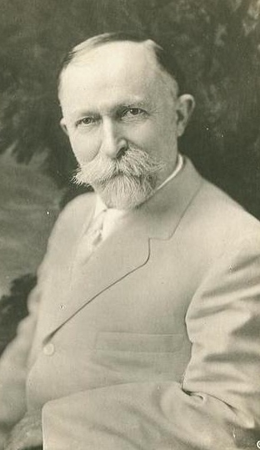
THE CHICAGO MISSION:
In 1893, the General Conference set up a Seventh-day Adventists’ Medical Missionary and Benevolent Association to operate a special outreach in Chicago. Dr. John Harvey Kellogg was made the president of this association.

Slide 29
THE CHICAGO MISSION:
PROGRAMS:
Free medical dispensary
Clothing distribution program
Homeless shelter (400/night)
Soup kitchen (500-1,500 daily)
Work at shelter: rug, carpet weaving, or broom making

Slide 30
THE CHICAGO MISSION:
PROGRAMS:
Lifeboat rescue home (halfway house for prostitutes)
Maternity home for unwed mothers
Farm outside of the city for drug rehab & homeless
School for the chinese
Visiting nurse service

Slide 31
THE CHICAGO MISSION:
MED SCHOOL PROGRAMS:
Dormitory for medical students
Home base for 8 visiting nurses working in the low-income residential area

Slide 32
THE CHICAGO MISSION:
SPONSORED ACTIVITIES:
A kindergarten
A day nursery for working moms
Free laundry for women
Classes in first aid, hygiene, diet, child training, & dress
Operated a free employment agency

Slide 33
THE CHICAGO MISSION:
SPONSORED ACTIVITIES:
Provided a placement service for orphans
Provided a placement service for men and women reclaimed from skid row

Slide 34
THE CHICAGO MISSION:
MEDICAL TRAINING:
Working in a Dispensary
Organizing Over 70 Clubs Among Newsboys, Bootblacks, and Street Kids
A Visitation Program to the City’s Jails that Included Classes in Gymnastics and Moral Instruction

Slide 35
God Has Provided Comprehensive and Detailed Instructions

Slide 36
Job Creation
“Attention should be given to the establishment of various industries so that poor families can find employment. Carpenters, blacksmiths, and indeed everyone who understands some line of useful labor should feel a real responsibility to teach and help the ignorant and the unemployed.”
Ministry of Healing, 194
Courtesy of the Ellen G. White Estate, Inc.

Slide 37
Job Training
“By instruction in practical lines, we can often help the poor most effectively. As a rule, those who have not been trained to work, do not have habits of industry, perseverance, economy, and self denial. They do not know how to manage. Often through lack of carefulness and right judgement, there is wasted that which would maintain their families in decency and comfort, if it were carefully and economically used.
Ministry of Healing, 194-195
Courtesy of the Ellen G. White Estate, Inc.

Slide 38
Practical Skills
“Let the members of the poor households be taught how to cook, how to make and mend their clothing, how to nurse the sick, how to care properly for the home. Let the boys and girls be thoroughly taught some useful trade or occupation.”
Ministry of Healing, 194
Courtesy of the Ellen G. White Estate, Inc.

Slide 39
Reducing Inequities in Health: What Each of Us Can Do

Slide 40
What SDA Hospitals Can Do
Give emphasis to prevention in the delivery of care
Develop incentives and interventions to reduce (normally occurring) implicit biases that lead to inequities in care
Provide care that addresses whole-person needs of clients (e.G. Address barriers in client’s environment; link to the non-medical resources that can assist clients)
David R. Williams, Adventist Review, February, 2016

Slide 41
What SDA Churches Can Do
Develop programs that enhance members’ and the community’s knowledge of food, fitness, and sleep, and encourage healthy choices
Offer programs and outreach services to low income persons to ensure that they have a marketable trade or skill to earn adequate income to support good health
David R. Williams, Adventist Review, February, 2016

Slide 42
What Church Members Can Do
Volunteer with church or community programs that provide services and support advocacy for “the least of these”
Spend more time with people in distress (e.g. volunteer for a crisis hotline; mentor children at risk of academic failure)
Become informed about social needs in your community and ask God’s guidance in making the love of Jesus real to people in need
David R. Williams, Adventist Review, February, 2016

Slide 43
Example of Jesus (MH)
He was always patient and cheerful. (p. 19)
None who came to Him went away unhelped. (p. 17)
The Savior’s work was not restricted to any time or place. His compassion knew no limit. (p. 17)
It was heaven to be in His presence. (p. 18)
With tender, courteous grace He ministered to the sin-sick soul, bringing healing and strength. (p. 23)
Courtesy of the Ellen G. White Estate, Inc.

Slide 44
Why Jesus Waits
“Christ is waiting with longing desire for the manifestation of Himself in His church. When the character of Christ shall be perfectly reproduced in His people, then He will come to claim them as His own. It is the privilege of every Christian not only to look for but to hasten the coming of our Lord Jesus Christ.
Courtesy of the Ellen G. White Estate, Inc.
Christ’s Object Lessons, 69

Slide 45
Why Jesus Waits
“…Were all who profess His name bearing fruit to His glory, how quickly the whole world would be sown with the seed of the gospel. Quickly the last great harvest would be ripened, and Christ would come to gather the precious grain.”
Christ’s Object Lessons, 69
Courtesy of the Ellen G. White Estate, Inc.

